Slide 1



SuperStore Sales
View in Power BI
Last data refresh:
25/08/2024 16:12:49 UTC
Downloaded at:
25/08/2024 16:22:26 UTC

Slide 2
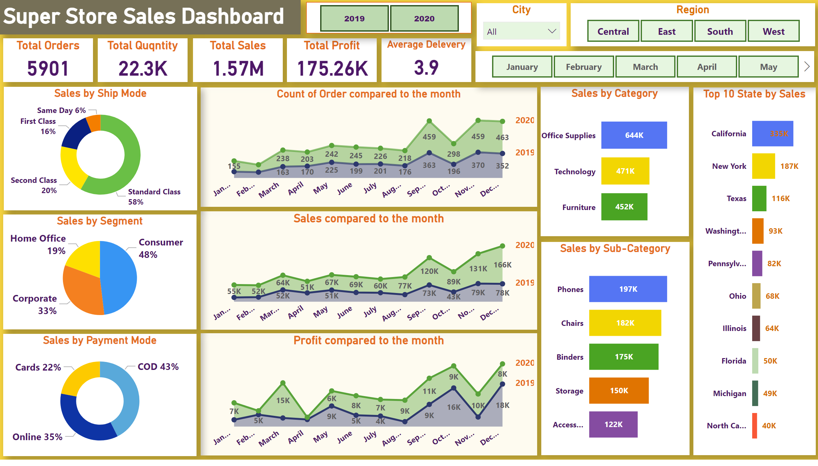
Sales
Notes:
textbox
No alt text provided
textbox
No alt text provided
Total Orders
No alt text provided
Total Quqntity
No alt text provided
Total Sales
No alt text provided
Total Profit
No alt text provided
Average Delevery
No alt text provided
slicer
No alt text provided
Count of Order compared to the month
No alt text provided
Sales compared to the month
No alt text provided
Profit compared to the month
No alt text provided
Sales by Ship Mode
No alt text provided
Sales by Segment
No alt text provided
Sales by Payment Mode
No alt text provided
Sales by Category
No alt text provided
Sales by Sub-Category
No alt text provided
Top 10 State by Sales
No alt text provided
Region
No alt text provided
City
No alt text provided
Month
No alt text provided

Slide 3
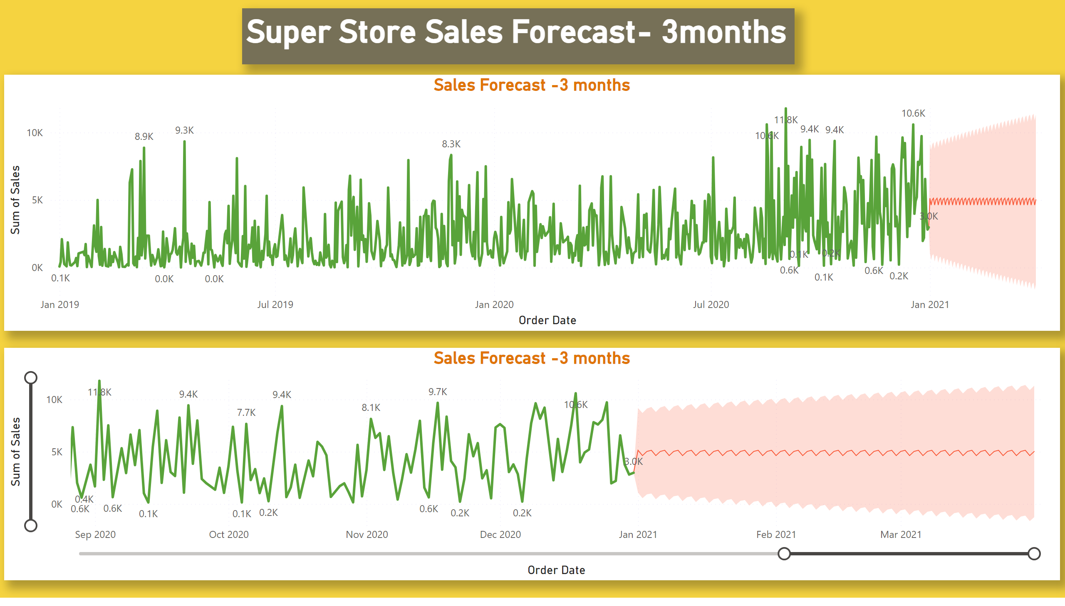
Sales Forecast
Notes:
textbox
No alt text provided
textbox
No alt text provided
Sales Forecast -3 months
No alt text provided
Sales Forecast -3 months
No alt text provided

